Slide 1

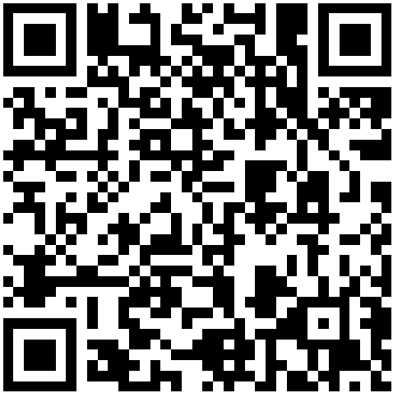


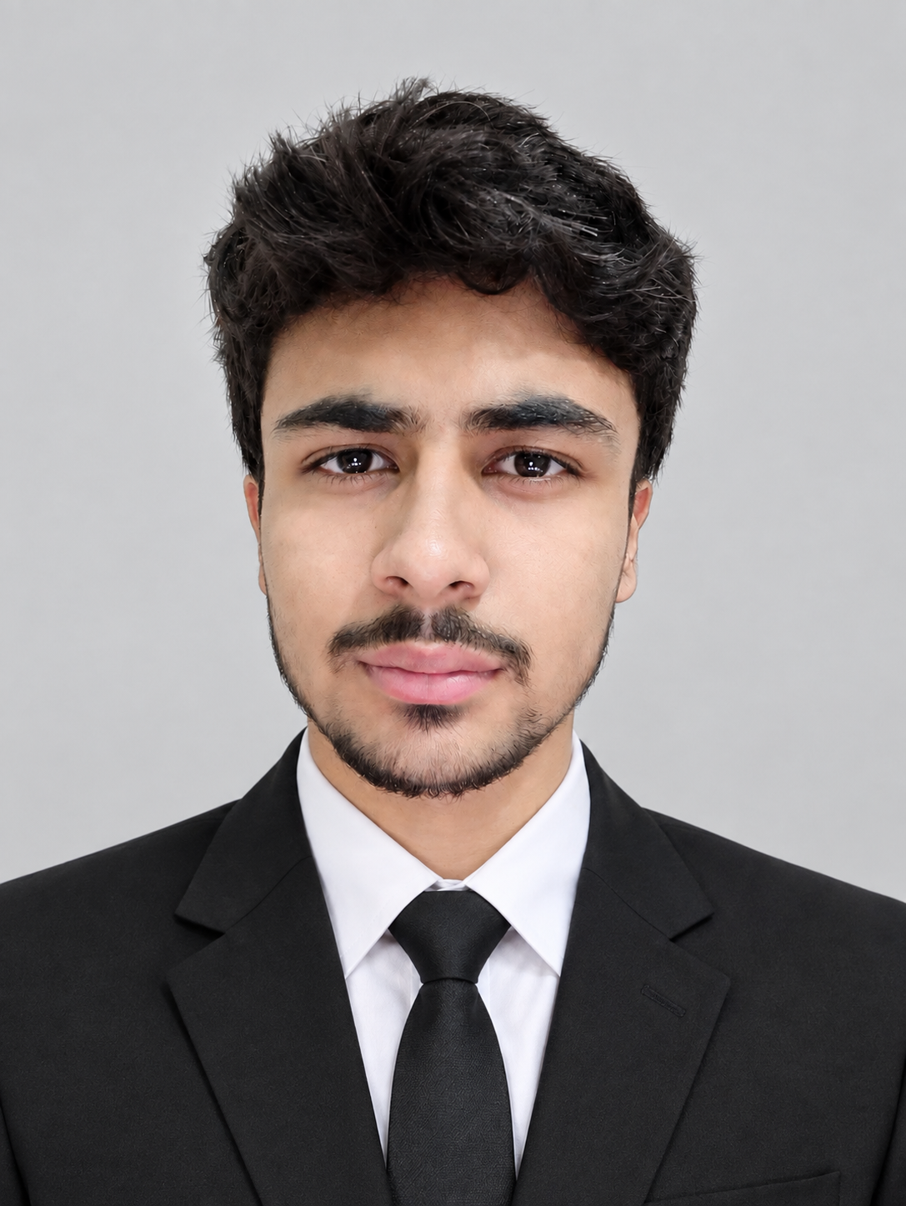
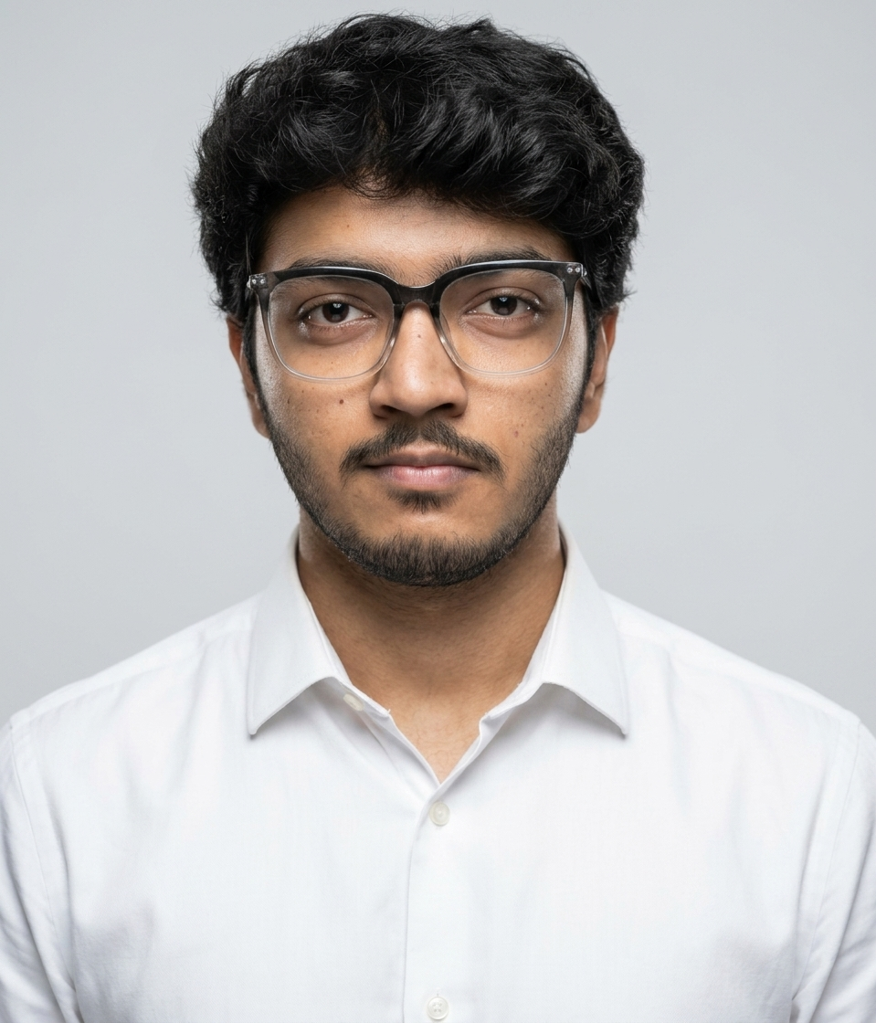

FAST NUCES
National University of Computer & Emerging Sciences
Anthropology | BS Software Engineering
Scan to visit our website
ANTHROPOLOGY OF COMMUNICATION
How Culture Shapes the Way We Speak
What Was Said vs. What Was Meant
01
The Words We Choose,
The Meaning We Hide
02
Gestures, Glances
& Personal Space
High-context cultures hide meaning in tone, relationship and situation; low-context cultures say it directly (Edward T. Hall).
Polite indirectness protects “face”: “We’ll see” or “Dekhte hain” can quietly mean no.
Idioms, proverbs and honorifics carry values that never translate word for word.
Proxemics: every culture has its own comfortable distance for intimate, personal, social and public talk.
Eye contact signals respect in one culture and challenge or rudeness in another.
The same gesture, such as a thumbs-up or a head nod, can carry opposite meanings across borders.
03
The Power
of Silence
04
The Cost of Misleading
Cultural Communication
Silence can mean respect, agreement, disagreement, thought or deep discomfort.
Japanese ma and Western Apache silence (Keith Basso) treat pauses as meaningful, not empty.
Where talk is valued, silence feels awkward; where listening is valued, interrupting it feels rude.
Lost deals, failed negotiations and workplace conflict grow from misread signals.
Misunderstandings in healthcare, education and diplomacy can harm real people.
Judging others by our own norms is ethnocentrism; the cure is curiosity, observation and clarifying questions.
Communication is not only what we say; it is what our culture taught us to mean.
Under the supervision of
Presented by
Dr. Shahnawaz Muhammad Khan
PhD (Int. Rel.), FUUAST, Islamabad
Hammad Ahmed
26K-3058
Arsum Ali
26K-3045
Zunair Azeem
26K-3044
Taha Islam
26K-3051

